Slide 1
Solve CSPs using Constraint Propagation

Slide 2








Can CSPs be solved using searching on state space?
Yes, but
CSP solvers (e.g., constraint propagation methods) can be faster than state-space searchers because
For example, once we have chosen {HaNoi = blue}

Slide 3












Constraint propagation
Using the constraints to reduce the domain (legal values) for a variable,
which in turn
➔

Slide 4





Local consistency: the key idea of constraint propagation
Enforcing local consistency in each part of the graph causes inconsistent values to be eliminated throughout the graph.
Types of local consistency:

Slide 5
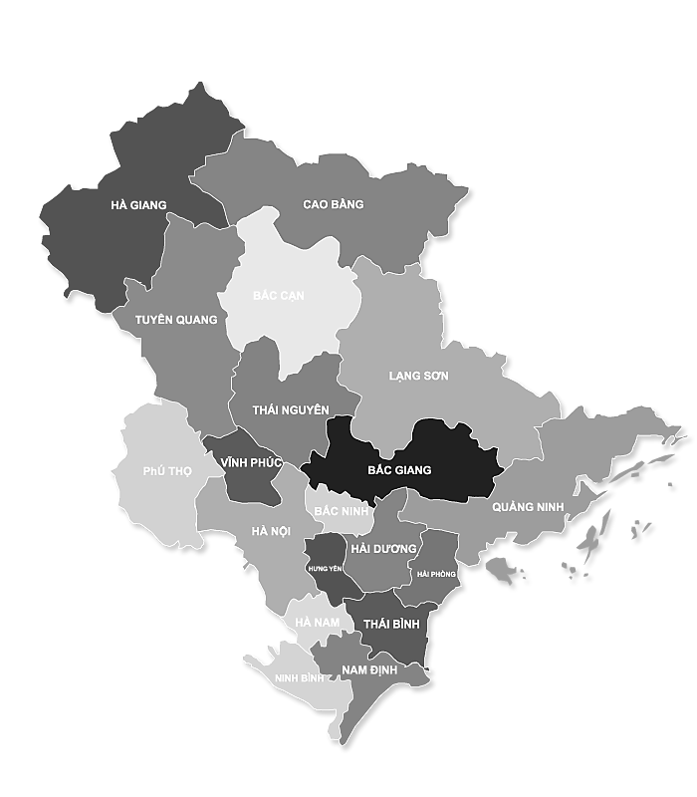





















Constraint graph
Nodes:
Arcs:

Slide 6














Node consistency
Enforcing domains to satisfy unary constraints.
For example,

Slide 7




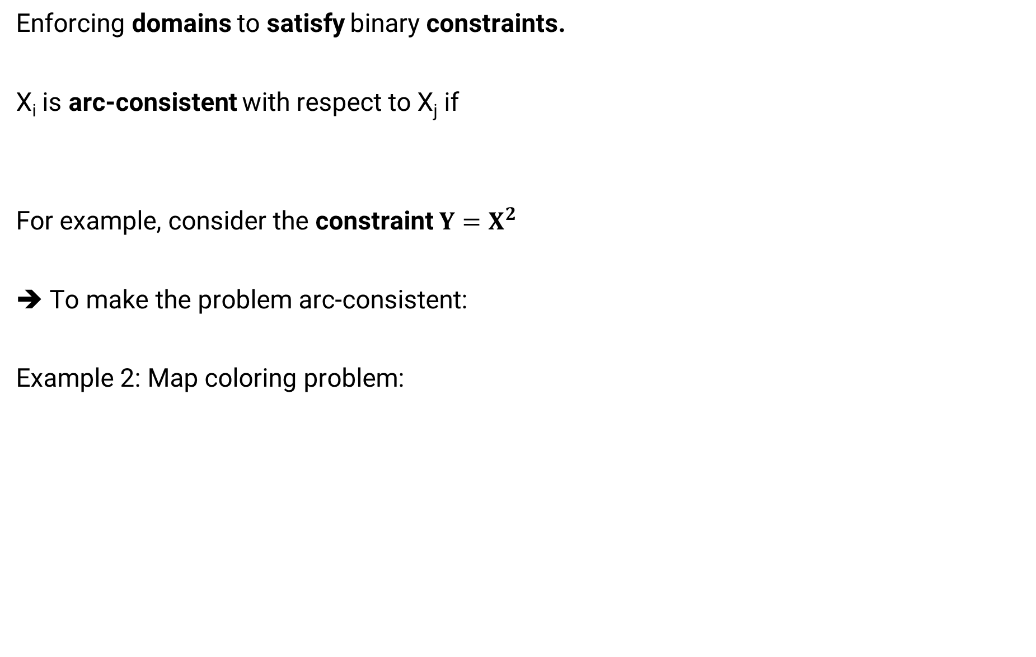
Arc consistency
Enforcing domains to satisfy binary constraints.
X_{i} is arc-consistent with respect to X_{j} if
For example, consider the constraint $Y=X^{2}$
➔ To make the problem arc-consistent:
Example 2: Map coloring problem:

Slide 8
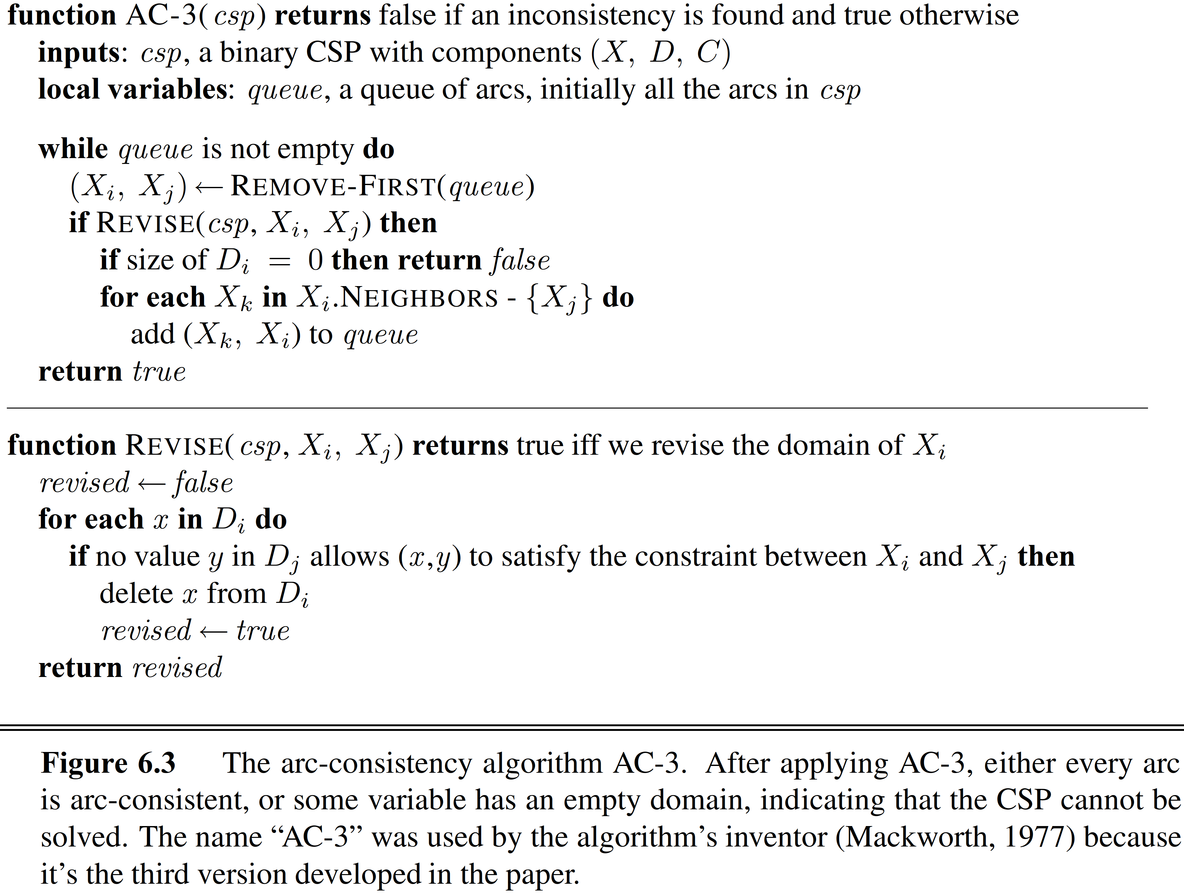


AC-3 algorithm
Source: (Russell, 2016)

Slide 9
Path consistency
Arc consistence can help reduce the domains of variables.
However, sometimes it tasks no effect.
Path consistency:
A two-variable set {X_{i}, X_{j}} is path-consistent wrt variable X_{m} if, for every assignment {X_{i} = a, X_{j} = b} consistent with the constraints on {X_{i}, X_{j}}, there is an assignment to X_{m} that satisﬁes the constraints on {X_{i}, X_{m}} and {X_{m}, X_{j}}.

Slide 10





Example
In the map coloring problem: if we use only
2 colors {red, blue}
Constraint: X ≠ Y
Arc-consistent?
Yes, since with each color of X,
Path-consistent?
Consider {HaNoi = red, BacNinh = blue},

Slide 11
PC-2 algorithm can enforce path consistency.
It is very similar to AC-3 algorithm.

Slide 12



K-consistency
A general form of local consistency.
A CSP is k-consistent if, for any set of k − 1 variables and for any consistent assignment to those variables, a consistent value can always be assigned to any k^{th} variable.
Some special cases:
1-consistency:
2-consistency:
3-consistency:

Slide 13
























Global constraints
A global constraint is one involving an arbitrary number of variables
For example, the Alldiff constraint

Slide 14


Global constraints
Example 2: Atmost constraint: in the car assembly scheduling problem,
➔ Enforce consistency by deleting the maximum value of any domain if

Slide 15
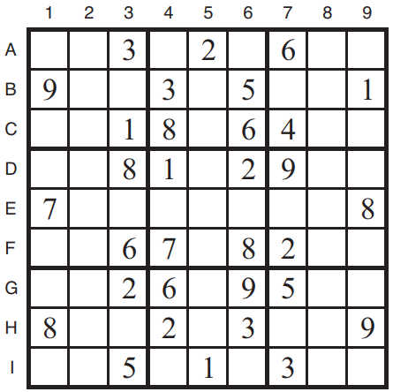
Sodoku problem
No digit appears twice in any row, column, or 3 × 3 box.
Image: (Russell, 2016)

Slide 16













Sudoku puzzle as a CSP
Variables:
Domains:
Constraints:
Image: (Russell, 2016)

Slide 17
Alldiff constraints of a sudoku problem:
Source: (Russell, 2016)

Slide 18
Solving a Sudoku puzzle
Approach 1: AC-3 algorithm
Directly reducing domains of variables using the constraints.
Image: (Russell, 2016)

Slide 19













Solving a Sudoku puzzle
Approach 2: Triplets
In an unit, find 3 squares
Remove these 3 numbers from domains of
Image: (Russell, 2016)

Slide 20




Notes
The mentioned approaches can apply to any CSPs, not just Sodoku.

